Slide 1
What New?
VS 2015 RC/ASP.NET 5

Slide 2
Overview
Visual Studio 2015 RC
Where you can get it
Review what’s new
Included C# 6 Language Feature
New tools and feature – CodeLens, Code Analysis, Diagnostic tools etc..
ASP.NET 5
What changed
How to get started

Slide 3
VS 2015 – c# 6 Language Features
Nameof provides a refactoring-safe way of getting the name of e.g. a parameter, member or type as a string.
Using null-conditional operators, you can get a built-in null check while accessing and invoking members and indexers.
String interpolation: String interpolation provides a concise way of describing string templates that insert expressions into format strings (C# only at Preview, both VB and C# at RTM).
Methods, getter-only properties, etc., can now have a single expression as their body, just like lambdas.

Slide 4
VS 2015 – c# 6 Language Features -cont
Auto-properties can have initializers and no longer require setters.
Index initializers: Inside an object initializer, you can now initialize a specific index of the new object. C# only.
Exception filters let you look at an exception and decide whether to catch it with a given catch block.
Using clauses for static classes bring their static members directly into scope, so you can call for example WriteLine() or Sqrt() without prefixing with the class name.
Await now works in catch and finally blocks, obviating some very tricky workarounds.

Slide 5

DEMO

Slide 6
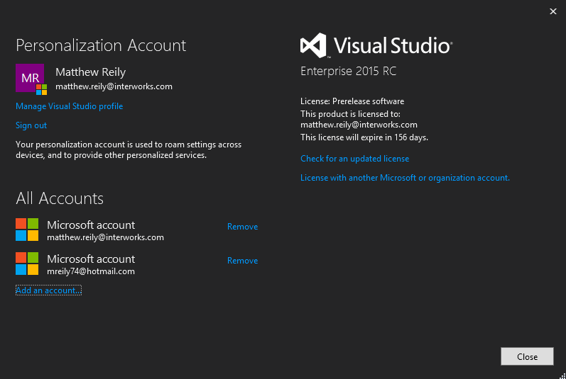
Sign In Across Multiple Accounts
Notes:
With Visual Studio 2015, the new streamlined sign-in experience is designed to greatly simplify your access to online resources, even when you have multiple Visual Studio accounts. After you sign-in to Visual Studio, you are automatically signed in to all instances of Visual Studio 2015 and Blend on your machine. Signing in unlocks the prerelease and automatically starts roaming your settings for you. In Visual Studio 2015, your account is shared across features so, as long as you have a good token, you can access your Visual Studio Online account(s) fromTeam Explorer, and resources and websites from your Microsoft Azure subscription in Server Explorer. You’ll also see your Azure resources in the New Project Dialog for Application Insights projects, and you’ll see your Azure Mobile, Azure Storage, and Saleforce.com developeraccounts in the new Add a Connected Service dialog. You will also see a link to Microsoft Office 365 there, and you can use those services but as of the preview release you will still have to sign in separately. We expect that by the time Visual Studio 2015 RTM releases, Microsoft Office 365 and possibly other services will support this streamlined sign-in experience.
You can work with multiple user accounts in Visual Studio by adding them as you go or through the new Account Manager. Then, you can switch between those accounts on the fly when connecting to services or accessing online resources. Visual Studio remembers the accounts you add so you can use them from any instance of Visual Studio or Blend. By RTM, Visual Studio will also roam the list of accounts (though we won’t roam your valuable credentials) with your Personalization account so you can quickly start working with one of those accounts on another device. Of course, you can remove accounts from the Account Settings dialog at any time.

Slide 7
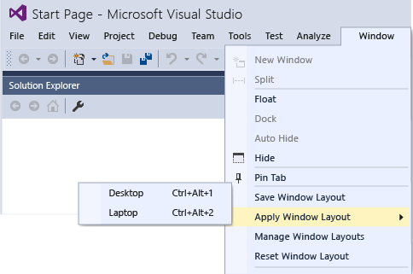
Custom Window Layouts

Slide 8
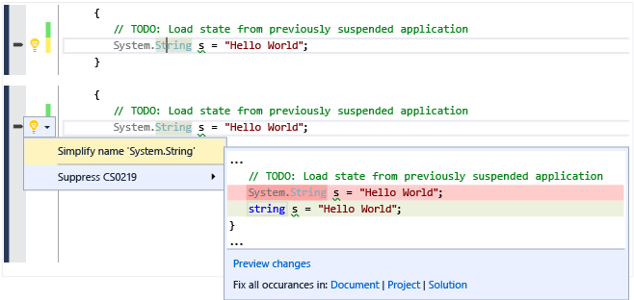
Live code Analysis – (Light Bulbs)
Notes:
The code editor UI and editing experiences for C# and Visual Basic have been replaced with new experiences built on the .NET Compiler Platform ("Roslyn"). Many of the features you love today have been improved or revamped.
Light Bulbs are the new home for all quick actions you take in the Visual Studio Editor, including fixes to common code issues and refactoring code. When you have issues in your code, a Light Bulb shows suggested fixes for those issues. All refactoring operations have been moved to the Light Bulb, which you can access any time by typing Ctrl + <dot>.
There are two new core refactoring operations: Inline temporary variable and Introduce local. Here’s an example of the new Introduce local feature:
Refactoring support for Visual Basic has been added for the first time, and has also been moved to the Light Bulb.
Renaming has also been improved; now it highlights all the instances of the identifier you want to rename, letting you type the new name to all instances at once directly in the editor.

Slide 9
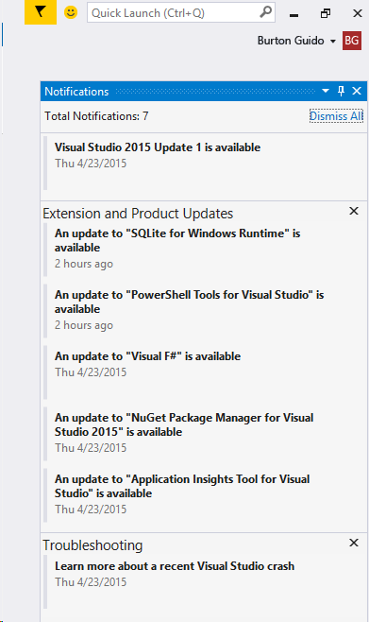
Visual Studio Notifications
Notes:
Visual Studio notifies you when an update is available for Visual Studio itself or for any of the components that it knows about. It also provides notifications about certain kinds of events that occur in the Visual Studio environment. The notification icon is a flag in the upper right of the Visual Studio title bar; when the icon is red, it means there are updates available for you to install, or events such as crashes that you might want to know more about. You can click on the icon to see a list of the notifications and choose which ones to install act on. You can choose to always ignore a notification, and Visual Studio will stop showing it.

Slide 10
UI debugging tools for XAML!!!!!
Notes:
We've added two new tools—the Live Visual Tree and the Live Property Explorer—that you can use to inspect the visual tree of your running WPF application, as well as the properties on any element in the tree. In short, these tools will allow you to select any element in your running app and show the final, computed and rendered properties. Here's more:
Live Visual Tree. Now, you can view the full visual tree of a running application during a debug session. The Live Visual Tree is available when you press F5 in Visual Studio or attach to a running application. You can use the Live Visual Tree to select elements in a running application for inspection in the Live Property Explorer. Descendant count is displayed, and if the source information is available, you can instantly find the file and location of the element's definition.
Live Property Explorer. Use this new tool to inspect the properties set on any element in a running application, grouped by the scope in which they are set. You can modify these properties during a debugging session and immediately see their changes in the running application.
Picking apart how properties override each other and figuring out winning behavior can prove difficult at design time. Now, by using our new UI debugging tools for XAML, you can perform these inspections at runtime, when you can take everything into account.

Slide 11
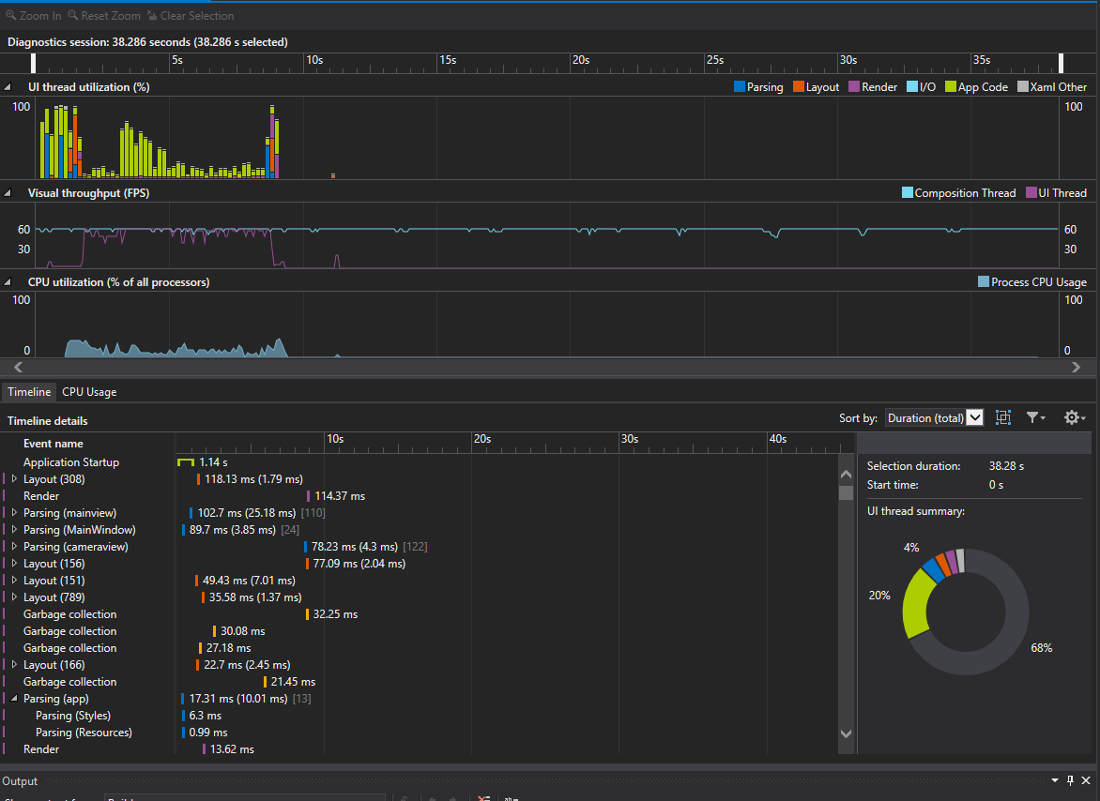
Timeline Tool
details
Notes:
Our new Timeline tool provides you with a scenario-centric view of the resources that your applications consume, which you can use to inspect, diagnose, and improve the performance of your WPF and Windows Store 8.1 applications.
The Timeline tool, which is in the Performance and Diagnostics hub, shows you how much time your application spends in preparing UI frames and in servicing networks and disk requests, and it does so in the context of scenarios such as Application Load and Page Load.

Slide 12
Diagnostics Tools
A new Diagnostic Tools window has been added that appears when you start debugging (press F5). The Diagnostics Tools window contains the following features:
Debugger Events (with IntelliTrace)
Memory Usage
CPU Usage
This tool replaces the CPU time PerfTip that was available in the Preview release of Visual Studio 2015.)
Notes:
new Diagnostic Tools window that appears when you start debugging (press F5). The Diagnostics Tools window contains the following features:
Debugger Events (with IntelliTrace)
Debugger Events (with IntelliTrace) gives you access to all Break, Output, and IntelliTrace events collected during your debugging session. The data is presented both as a timeline and as a tabular view. The two views are synchronized and can interact with each other.
Memory Usage
The Memory Usage tool allows you to monitor the memory usage of your app while you are debugging. You can also take and compare detailed snapshots of native and managed memory to analyze the cause of memory growth and memory leaks.
CPU Usage
The CPU Usage tool allows you to monitor the CPU usage of your application while you are debugging.
(This tool replaces the CPU time PerfTip that was available in the Preview release of Visual Studio 2015.)

Slide 13
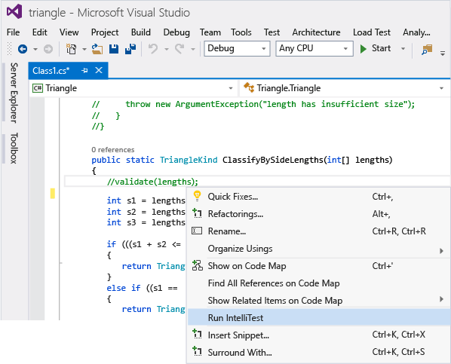
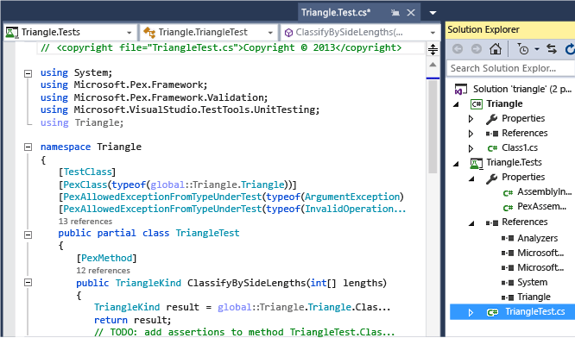
IntelliTest
Notes:
IntelliTest explores your .NET code to generate test data and a suite of unit tests. For every statement in the code, a test input is generated that will execute that statement. A case analysis is performed for every conditional branch in the code. For example, if statements, assertions, and all operations that can throw exceptions are analyzed. This analysis is used to generate test data for a parameterized unit test for each of your methods, creating unit tests with maximum code coverage. Then you bring your domain knowledge to improve these unit tests.
When you run IntelliTest, you can easily see which tests are failing and add any necessary code to fix them. You can select which of the generated tests to save into a test project to provide a regression suite. As you change your code, rerun IntelliTest to keep the generated tests in sync with your code changes.

Slide 14
Debugging and Diagnostics
Managed Edit and Continue on Attach
Now, in RC, you can edit and continue when you attach to .NET applications and when the environment variable complus_forceenc is set to 1 in the target process.
Breakpoint Configuration
Lambda Expressions in Debugger Windows
PerfTips
Notes:
Managed Edit and Continue on Attach
Now, in RC, you can edit and continue when you attach to .NET applications and when the environment variable complus_forceenc is set to 1 in the target process.
Breakpoint Configuration
The new Breakpoint Settings window allows you to specify conditions and actions for your breakpoints. The window includes improved IntelliSense support for breakpoint conditions and actions. You can use undo (CTRL+Z) to restore deleted breakpoints.
Lambda Expressions in Debugger Windows
You can now use lambda expressions in the Watch, Immediate, and other debugger windows in C# and Visual Basic.
PerfTips
You can use the PerfTips feature to see how long code took to execute directly in the editor when code execution exceeds a specified threshold.

Slide 15
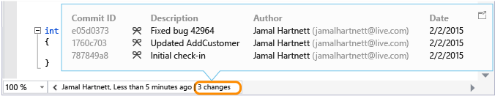
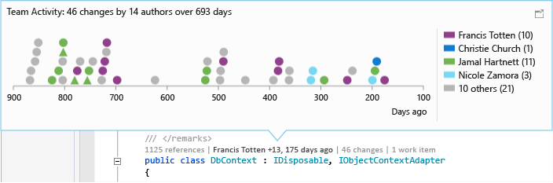
CodeLens
Notes:
Stay focused on your work while you find information about your code - without leaving the editor. You can review changes and other history for work items, bugs, code reviews, and so on for code that’s stored in Visual Studio Online (VSO) or in Team Foundation Server (TFS).
In Visual Studio Enterprise and Visual Studio Professional, you can now:
Get history for an entire code file in the Visual Studio editor when you use Git.
See a graph that shows the people who changed your code. This can help you find patterns in your team's changes and assess their impact.
Easily see when your code was last changed.
Find changes in other branches that affect your code.

Slide 16
ASP.NET 5 and Vs 2015 RC
The BIG rename
k and klr = DNX
kvm = dnvm
Kpm = dnu and nuget
The Aspnet50 and aspnetcore50 framework monikers in project.json files are being replaced with dnx451 and dnxcore50.
Notes:
If you’ve been following the previous releases of Visual Studio 2015 and the nightly builds of ASP.NET, you have no doubt been familiar with the Project K executables: k.exe, klr.exe, kpm.exe, and kvm.exe In order to drop the Project K codename and move to a more market-friendly name of the ASP.NET tooling, these command-line tools and the K-Runtime were renamed as follows:
k and klr are now DNX. DNX stands for .NET Execution Environment.
kvm is now dnvm or the .NET Version Manager
kpm is migrating some functionality of its functionality to dnu, the .NET Development Utility and some functionality will migrate to be core NuGet functionality
The Aspnet50 and aspnetcore50 framework monikers in project.json files are being replaced with dnx451 and dnxcore50.

Slide 17
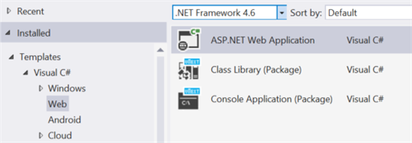
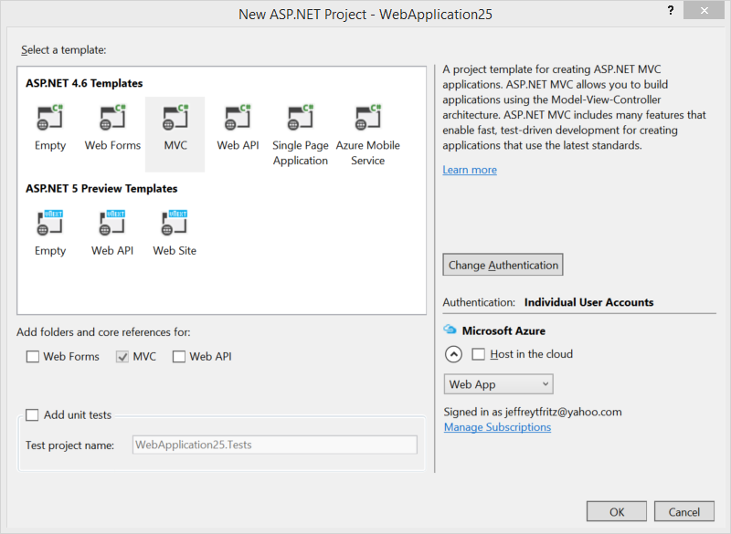
New Project Templates
Notes:
In the prior versions of Visual Studio 2015, we made project types available for Project K class library and Project K console applications. These project type names don’t make sense in our new world and we have renamed them appropriately:
Class Library (Package) is a class library project that is configured to allow you to build reference libraries that compile directly into NuGet packages. Console application is a similar project that allows console applications to be built in the same model as an ASP.NET 5 web application, referencing NuGet packages and configuring multiple frameworks to build against. Both of these project types allow the developer to configure everything with a project.json file and target the .NET Core framework.
We’ve also simplified and updated the ASP.NET web project templates in this release. There are clear dividing lines between the ASP.NET 4.6 and ASP.NET 5 projects, as well as updated templates for a Single Page Application and Azure Mobile Service:

Slide 18
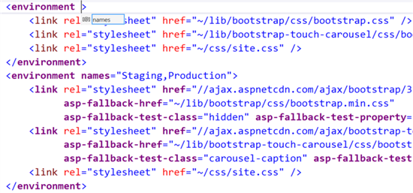
Editor Improvements to Support TagHelpers

Slide 19
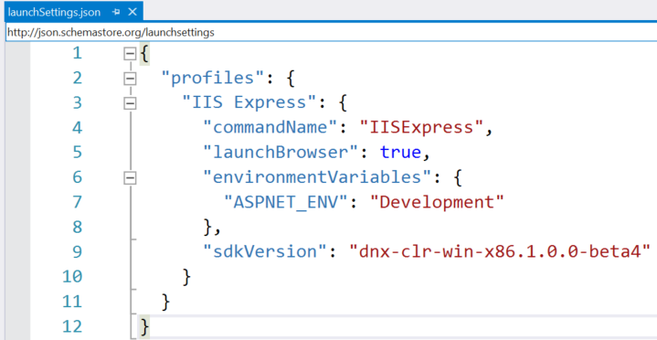
Custom Launch Settings are saved as Project Properties
Notes:
If you want to lock in the version of the framework that your project for compilation and debugging, those settings are now saved with your project in the new launchSettings.json file in your project properties folder. This means that all of your team members will have the same debugging configuration when they synchronize source code.
Additionally, we have simplified the format of this configuration file to make it easier to read and work with:

Slide 20

DEMO

Slide 21
References
https://www.visualstudio.com/news/vs2015-vs
https://msdn.microsoft.com/en-us/library/bb386063(v=vs.140).aspx
http://blogs.msdn.com/b/webdev/archive/2015/04/29/new-asp-net-features-and-fixes-in-visual-studio-2015-rc.aspx
http://www.hanselman.com/blog/ASPNET5VNextWorkInProgressExploringTagHelpers.aspx
https://msdn.microsoft.com/en-us/magazine/dn802602.aspx

Slide 22
Thank You
@matthewreily
matt@okcsharp.net
Code and slides
https://github.com/matthewreily/okcsharp-presentations

